Slide 1
IT Security and Penetration Testing
Chapter 1
Ethics of Hacking and Cracking

Slide 2
Objectives
Understand how the act of unethical computer hacking is a crime
Classify and identify groups and classes of hackers
Distinguish the rationale for various types of hackers

Slide 3
Objectives (continued)
Understand and determine differences in information warfare
Understand how computer hacking originated and its evolution
Recognize the importance of ethical hacking and the issues involved in hacker ethics

Slide 4
The Impact of Unethical Hacking
Computer cracking
Term for illegally hacking into a computer system without the permission of the system’s owner
Despite the motivations of computer crackers
Cracking a system is a crime

Slide 5
Hacker Communities
Two ways commonly used to categorize hackers
White Hat good hackers vs. Black Hat bad hackers
Based loosely on psychological profiling

Slide 6
Hat Categories
White Hat/Black Hat model
White hats represent the “good guys”
Black hats represent the “bad guys”
Everything the good guys do is right, legal, and justified
“Gray Hat” hackers
Evidence that the dichotomy of good and evil is NOT a very good fit to the real world

Slide 7
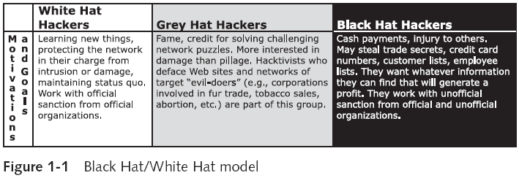
Hat Categories (continued)

Slide 8
Hacker Profiling
Hacking requires that the practitioner be intimately familiar with the techniques of the perpetrator
Or opponent
Reading and techniques used by both ethical and malicious hackers are identical
Profile of a hacker is multifaceted
Black Hat Briefings convention
Highlights breaking security research submitted by leading corporate professionals, government experts, and members of the underground hacking community

Slide 9
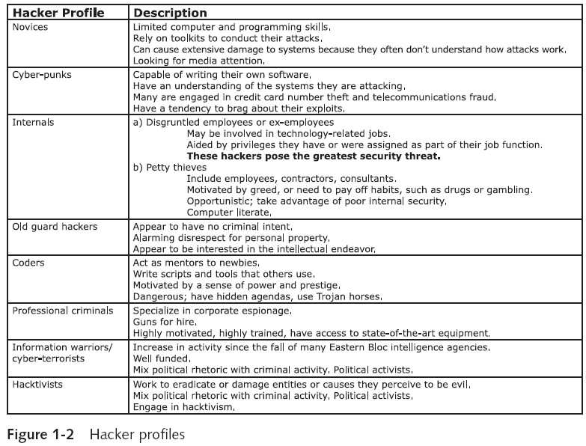

Slide 10
Hacker Motivations
Curiosity
Love of puzzles
Desire for recognition or fame
Revenge
Financial gain
Patriotism or politics

Slide 11
Ethical Hacking
Ethics are the principles of conduct that govern individuals, groups, and professions
Without a published code of ethics, it is difficult to gain public trust for a profession
Network security is emerging from a chaotic set of conflicting ethics
Separating the ethical hacker from the unethical cracker
Will allow security professionals to present the benefits of their profession

Slide 12
Evolution of Hacking
The modern concept of hacking began in the late 1950s
Students at the Massachusetts Institute of Technology started using their access to the MIT mainframe
To work on new languages
First password hacks were a response to the Compatible Time Sharing System (CTSS)
Developed in the early 1960s

Slide 13
Evolution of Hacking (continued)
In the 1970s phone phreaks used phreaking to access telephone networks
To make free calls from payphones
In the 1980s
War dialers were developed to search for open modems
Personal computer prices dropped and users became more common
Hacker communities also grew
Viruses, worms, and Trojans started appearing in 1988

Slide 14
Evolution of Hacking (continued)
Antisocial actions of crackers and script kiddies made it difficult to defend the original concept of hacking
“Computer hacker” describes computer experts with malicious intent

Slide 15
Ethics and Issues of Information Technology
There is a need for ethics within the hacking profession
There is currently no national certification standard for computer security professionals
Certificates available denote skill levels

Slide 16
Vendor-Neutral Security Certifications
Security certificates and issuing bodies
CompTIA Security+™ Certification
Global Information Assurance Certification (GIAC), Security Administration Certifications
ISC2 Certifications
Associate of (ISC)²
SSCP Examination

Slide 17
Vendor-Neutral Security Certifications (continued)
Security certificates and issuing bodies (continued)
CAP Examination
CISSP Examination
CISSP Concentrations
EC-Council Certifications

Slide 18
Vendor-Specific Security Certificates
There are almost as many vendor-specific certificates as there are network vendors
Cisco’s CCNA, and Microsoft’s MSCE
Useful to newcomers to the network security industry

Slide 19
What Needs to Be Secured
Protection of data provided to organizations or stored on personal computers is a high priority
Some crackers break into systems to utilize what they consider wasted computer energy
Using bandwidth without permission may seem harmless
But it is a crime, in addition to being unethical
Many hackers find it tempting to copy, download, and use proprietary software and other copyrighted works

Slide 20
What Needs to Be Secured (continued)
Ethical Issues of Hacking
Professional hackers have a responsibility to society
Their activities should help to build and improve upon existing technology
They should use their skills and interests as opportunities to learn and to teach
Ethical hacker
A security professional who applies his or her hacking skills for defensive purposes

Slide 21
What Needs to Be Secured (continued)
Ethical Hacking and System Security
Some companies prefer to pay an ethical hacker to discover their systems’ weaknesses and security gaps
Ethical hackers work to protect all areas of information technology
Hackers must have experience in software engineering, network engineering, and system security

Slide 22
Summary
Computer cracking is illegally hacking into a computer system without the permission of the system’s owner
Hackers are commonly thought of in two groups: White Hat and Black Hat
Nine major profiles of hackers
The techniques used by ethical and malicious hackers are similar
Hackers may be motivated by curiosity, puzzles, fame, revenge, money, or patriotism

Slide 23
Summary (continued)
The modern concept of hacking began in the late 1950s
While there are several vendor-neutral and vendor-specific certifications available to computer security professionals, there is no national certification standard
Professional security experts, technologists, and hackers must develop a public code of ethics
An ethical hacker is a security professional who applies hacking skills for defensive purposes

